Slide 1


Slide 2




Welcome!
Introductions
Can everyone access Noteable?
Is everyone in a space where they can actively participate (camera, microphone, screenshare)?
www.cdcs.ed.ac.uk

Slide 3

Week 1:
Writing and running code, Conditions & Logic
www.cdcs.ed.ac.uk

Slide 4
Programming = Telling the computer what to do
You need to speak a language the computer will understand, e.g., Python
www.cdcs.ed.ac.uk

Slide 5
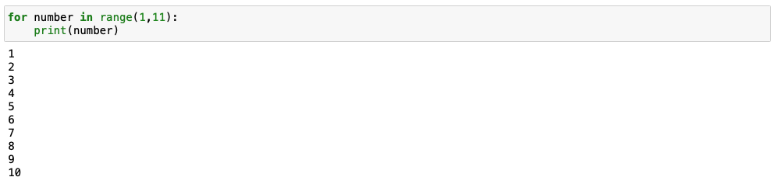
Syntax
Count from 1 to 10.
for number in range(1,11): print(number)
1, 2, 3, 4, 5, 6, 7, 8, 9, 10
🧑‍💻
www.cdcs.ed.ac.uk

Slide 6
Notebook 1a:
Writing & Running Code
www.cdcs.ed.ac.uk

Slide 7
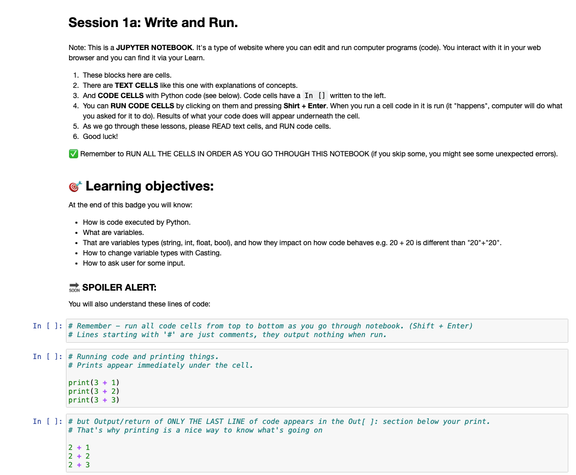
Jupyter Notebooks
Markdown cells
Code cells
www.cdcs.ed.ac.uk

Slide 8
Code is written in lines. Each line does something, and they are executed from top to bottom.
count = 43
print(count)
count = 44
print(count)
www.cdcs.ed.ac.uk

Slide 9

Variables are places to store values for later. There are different types of variables:
string for text, e.g., “banana” or “I like Python”
int (integer) for whole numbers, e.g., 1, 5, 2014
float for decimal numbers, e.g., 2.25, 6.1246, 16.2
bool (Boolean) for logic values: True, False
my_favourite_fruit = “apple”
“apple”
my_favourite_fruit
www.cdcs.ed.ac.uk

Slide 10
Noteable
https://noteable.edina.ac.uk/login
→ log in with your student/staff account
→ select Python 3 and start the server
→ click “+GitRepo” (top right) add the GitHub link below, and click “clone”.
https://github.com/DCS-training/IntroToPython_2023
www.cdcs.ed.ac.uk

Slide 11
Notebook 1b:
Conditions & Logic
www.cdcs.ed.ac.uk

Slide 12
Comparing Variables
2 < 2
2 < 3
3 > 2
2 <= 2
3 != 2
3 != 3
2 == 2
2 == 3
"apple" == "apple"
"apple" == "orange"
"apple" == "Apple"
”2023" == 2023
True
False
True
False
False
False
False
True
True
True
True
False
www.cdcs.ed.ac.uk

Slide 13
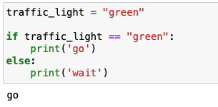
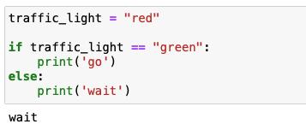
Conditionals
Controlling what part of your code gets executed based on conditions
E.g., “If the traffic light is green, go, otherwise, wait.”
www.cdcs.ed.ac.uk

Slide 14
Week 2:
Using and writing Functions
www.cdcs.ed.ac.uk

Slide 15
Welcome Back!
Whilst you are coming in, open up your web browser and load up Noteable:
https://noteable.edina.ac.uk/login
→ log in with your student/staff account
→ select Python 3 and start the server
→ from last week you should have all the files, if you do not then...
click “+GitRepo” (top right) add the GitHub link below, and click “clone”.
https://github.com/DCS-training/IntroToPython_2023
www.cdcs.ed.ac.uk

Slide 16

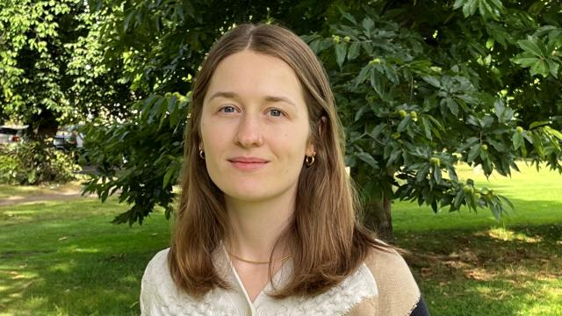
Welcome Back!
Chris Oldnall
Sarah Schöttler
www.cdcs.ed.ac.uk

Slide 17
Last week...
Write and run,
logic and conditionals.
...this week...
Functions,
and more functions!
www.cdcs.ed.ac.uk

Slide 18
What is a function?
2. Why do we use functions?
3. How do I make a function in Python?
www.cdcs.ed.ac.uk

Slide 19
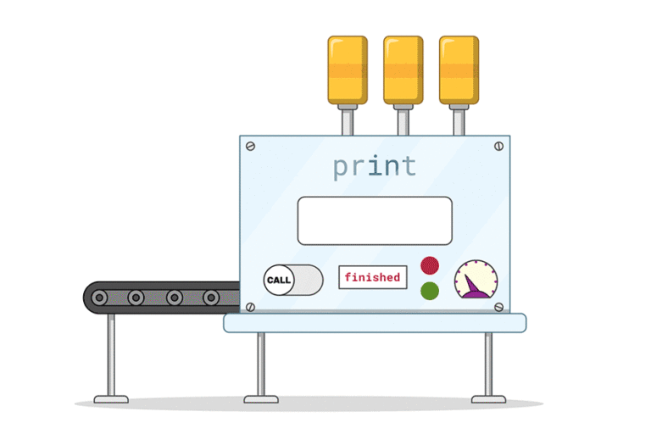
What is a function?
www.cdcs.ed.ac.uk

Slide 20
What is a function?
A way to generalise a process that will need to be done over and over again.
www.cdcs.ed.ac.uk

Slide 21
2. Why do we use functions?
Reduce lines of code,
Enhance computing performance,
Make life easier!
www.cdcs.ed.ac.uk

Slide 22

2. Why do we use functions?
www.cdcs.ed.ac.uk

Slide 23
3. How do I make a function in Python?
'def'
Name
What goes into it (arguments)
What it does (the steps)
What it gives back (return value)
www.cdcs.ed.ac.uk

Slide 24
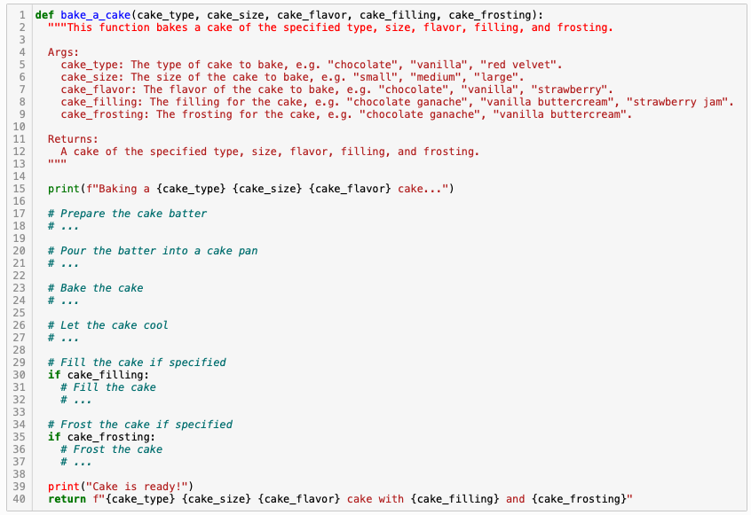
3. How do I make a function in Python?
www.cdcs.ed.ac.uk

Slide 25
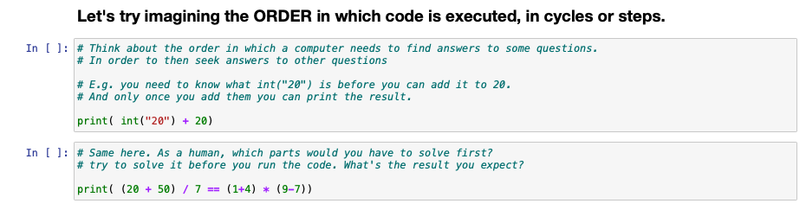
Let's do some programming:
Session 2 –
Functions = superpowers.
www.cdcs.ed.ac.uk

Slide 26
What is scope all about?
www.cdcs.ed.ac.uk

Slide 27


Local:
Only those close to him (within the same function) who know about what he can do.
Global:
Can be accessed by anyone, anywhere – everyone knows what he can do!
www.cdcs.ed.ac.uk

Slide 28
Rule 1: Anything inside a function is mysterious to the outside...
You are not able to peek inside of a function elsewhere in code. Only things returned will become available to the 'global' environment.
Rule 2: Functions can look outside, but shouldn't...
Things can get complicated when a function looks outside. We tackle this by carefully specifying arguments with relevant names.
www.cdcs.ed.ac.uk

Slide 29
Let's keep programming:
Session 2 –
Functions = superpowers.
www.cdcs.ed.ac.uk

Slide 30
Week 3:
Lists and collections
www.cdcs.ed.ac.uk

Slide 31
Recap: Variables
Variables are places to store values for later. There are different types of variables:
string for text, e.g., “banana” or “I like Python”
int (integer) for whole numbers, e.g., 1, 5, 2014
float for decimal numbers, e.g., 2.25, 6.1246, 16.2
bool (Boolean) for logic values: True, False
my_favourite_fruit = “apple”
“apple”
my_favourite_fruit
www.cdcs.ed.ac.uk

Slide 32
Lists
planet0 = "Mercury"
planet1 = "Venus"
planet2 = "Earth"
planet3 = "Mars"
planet4 = "Jupyter"
planet5 = "Saturn"
planet6 = "Uranus”
planets = ["Mercury", "Venus", "Earth", "Mars", "Jupyter", "Saturn", "Uranus"]
www.cdcs.ed.ac.uk

Slide 33
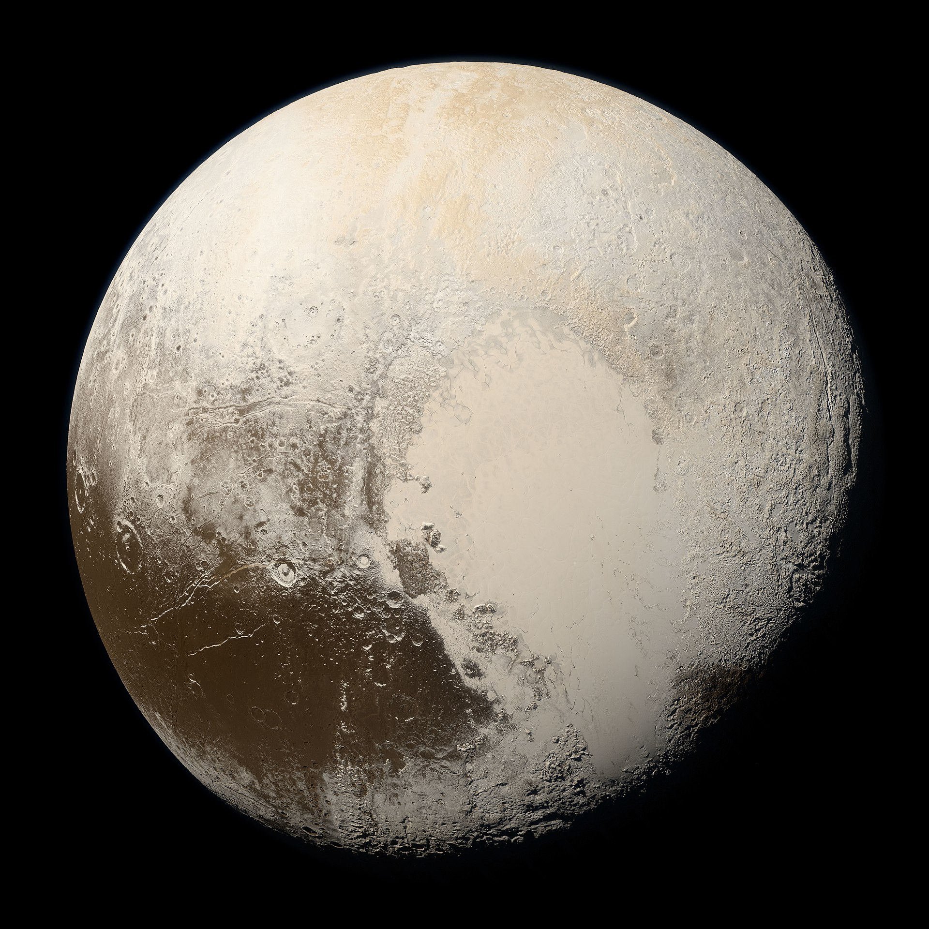
Why use lists?
planets = ["Mercury", "Venus", "Earth", "Mars", "Jupyter", "Saturn", "Uranus"]
✅ Count how many items are in the list
✅ Check if a specific item is in the list
✅ Find the location of a specific item
✅ Add and remove items
✅ Sort (alphabetically or otherwise)
Pluto (not a planet)
www.cdcs.ed.ac.uk

Slide 34
Alternatives to lists
Tuple
planets = ("Mercury", "Venus", "Earth", "Mars", "Jupyter", "Saturn", "Uranus”)
Uses () instead of []
Same as a list, except it cannot be changed after creating it
Set
planets = {"Mercury", "Venus", "Earth", "Mars", "Jupyter", "Saturn", "Uranus”}
Uses {} instead of [] (list) or () (tuple)
Same as a list, except:
Every item is unique (items cannot be listed twice)
Order does not matter and will change (no indexing)
www.cdcs.ed.ac.uk

Slide 35
Dictionaries
Used to store multiple pieces of information about one thing
Uses key-value pairs: each piece of data (value) has a label (key)
mercury = {“name”: “Mercury”, “day_length”: 59, “hottest_temp”: 430}
Combining lists and dictionaries is useful for real-world data: We often have multiple pieces of information about lots of different things and want to work with all of it at the same time!
planets = [ {“name”: “Mercury”, “day_length”: 59, “hottest_temp”: 430},
{“name”: “Venus”, “day_length”: 243.025, “hottest_temp”: 462},
{“name”: “Earth”, “day_length”: 1, “hottest_temp”: 56.7},
…
]
www.cdcs.ed.ac.uk

Slide 36
Let's get programming:
Session 3a –
Collections
www.cdcs.ed.ac.uk

Slide 37
What are list comprehensions?
www.cdcs.ed.ac.uk

Slide 38
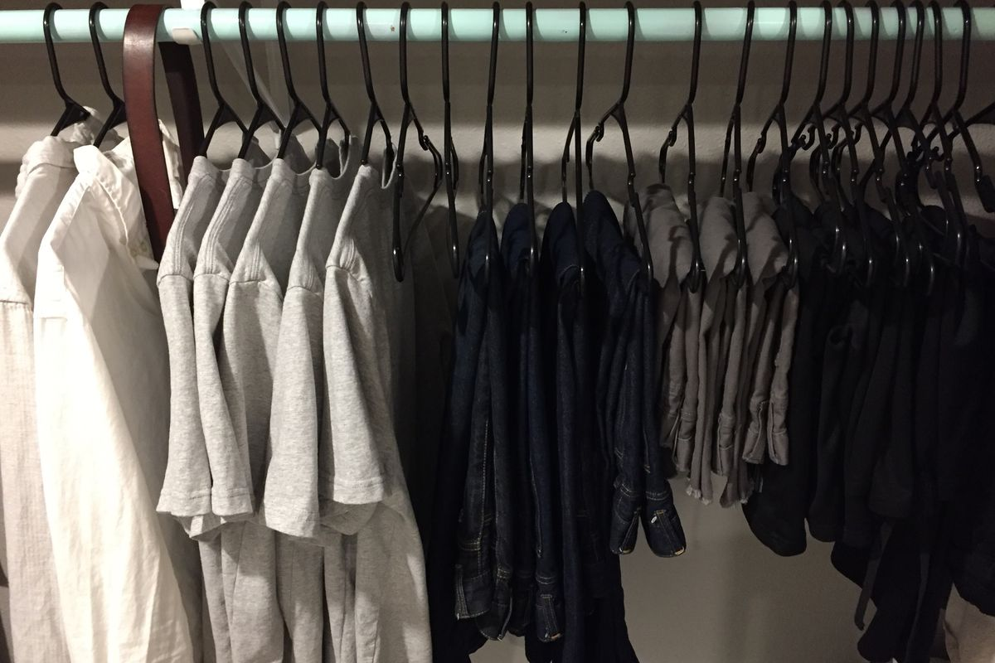
www.cdcs.ed.ac.uk

Slide 39
How do I get someone to pick the shirts from the wardrobe?
Say that it is the shirts you want,
For each item of clothing, check if it is a shirt,
If it’s a shirt, then take it out the wardrobe.
www.cdcs.ed.ac.uk

Slide 40
shirts = [
item_of_clothing
for item in wardrobe:
if item == shirt
]
www.cdcs.ed.ac.uk

Slide 41
initial_list = [thing1, thing2, …]
variable_name = [
<thing to get new list of>
for item in initial_list:
if item ==/>/< <some condition>
]
www.cdcs.ed.ac.uk

Slide 42
How do I get someone to pick the shirts from the wardrobe?
Say that it is the shirts you want,
For each item of clothing, check if it is a shirt,
If it’s a shirt, then take it out the wardrobe.
www.cdcs.ed.ac.uk

Slide 43
Some maths functions that may come in handy...
www.cdcs.ed.ac.uk

Slide 44
max( ) / min() Get the largest/smallest element in a group. For letters it will mean 'highest/lowest in the alphabet'.
len( ) Size of the collection, can be used on lists, dicts, but also on strings.
sum( ) Combine all elements. Just used for numbers.
www.cdcs.ed.ac.uk

Slide 45
Let's keep programming:
Session 3b –
List Comprehensions
www.cdcs.ed.ac.uk

Slide 46
Finishing up...
How to import data
Additional resources
Feedback for us
www.cdcs.ed.ac.uk

Slide 47
How to import data
To import data there is a range of methods, the easiest is using the package 'pandas'
Eg.
import pandas as pd
data_frame = pd.read_csv("<Your File Pathway>")
www.cdcs.ed.ac.uk

Slide 48
Additional Resources
This course used (slightly modified) notebooks from Code Storytelling (http://www.codestorytelling.com). We covered badges 1,2,4,5,7, and 8. Consider working through some more of the notebooks and watching some of the videos.
Think Python is an introductory Python book with many exercises, free to read online: https://greenteapress.com/wp/think-python-2e/
www.cdcs.ed.ac.uk

Slide 49
Feedback for us...
We hope you've enjoyed the course as much as we did.
It is really useful for us to hear your feedback
https://forms.office.com/r/YYNrqvuNr8
Should be really quick and only take 5 mins (maximum!)
www.cdcs.ed.ac.uk

Slide 50
Thank you from us!
Getting started with version control: Introduction to git and GitHub
Introduction to Statistics
www.cdcs.ed.ac.uk

